Slide 1
Price Prediction for Mobile Phones
Feature Extraction & Price Prediction
Nexthikes Project
By: Garima Choraria

Slide 2
Introduction
In current situation mobile phone plays important role so as data analysist its important to understand the factor that effects the price of mobile.
In this project we are focused about the price of mobile phone depending on its features like RAM, Battery, Camera, Processor, etc.
This project focus on driving the price of the mobile using different models and predict most accurate price of mobile.
This dataset is consist of 541rows and 12columns including features like memory, RAM, battery capacity, rear camera, AI lens, mobile height and Prize.

Slide 3
Project Task
Uploading Data
Data Pre-Processing
Data Exploration(EDA)
Feature Engineering
Model Building
Model Evaluation
Feature Important Analysis

Slide 4
Data Pre-Processing
In the given dataset there is no null values and duplicate values.
Prize column was in object dtype which was converted into integers.
Front Camera and Rear Camera was converted into integers.
Dropped unwanted column i.e Unnamed:0

Slide 5
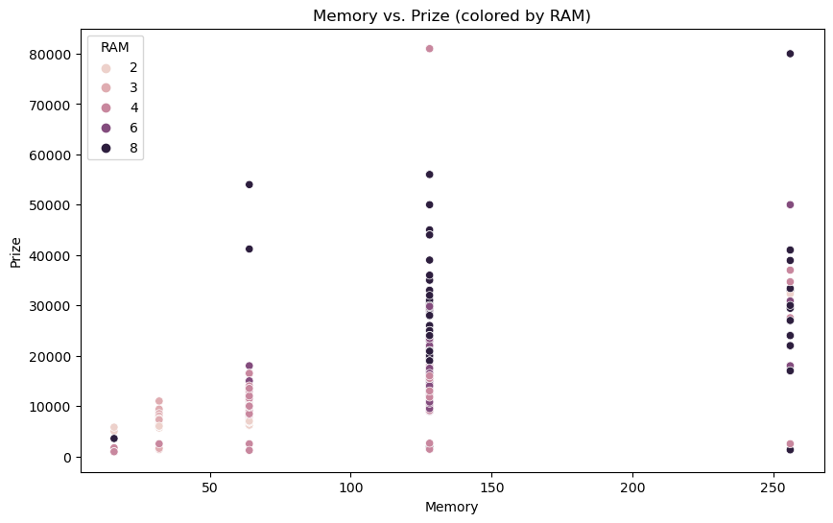
EDA
In the given dataset EDA has performed to find the insight of the data.
This scatter plot shows the relationship between the memory, RAM, and the price of mobile phones. As expected, higher memory and RAM generally correspond to higher prices, but there is still a significant variation within each group.
This scatter plot shows the relationship between the memory, RAM, and the price of mobile phones. As expected, higher memory and RAM generally correspond to higher prices, but there is still a significant variation within each group.

Slide 6
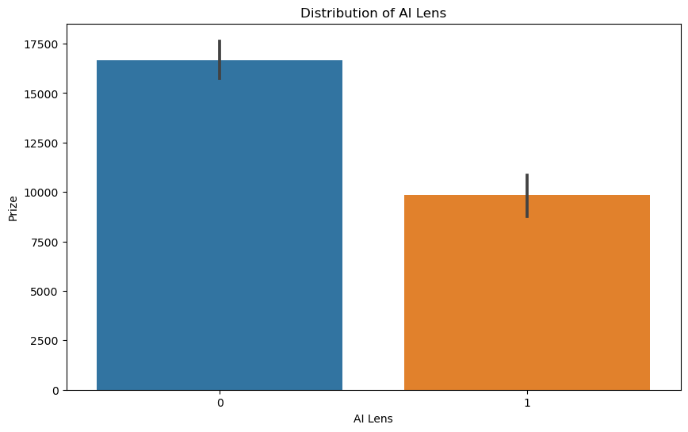
This bar chart shows the distribution of the 'AI Lens' feature, which is a binary variable (0 or 1). The majority of mobile phones in the dataset do not have an AI lens (0).These visualizations provide insights into the relationships between features and the target variable (price).

Slide 7
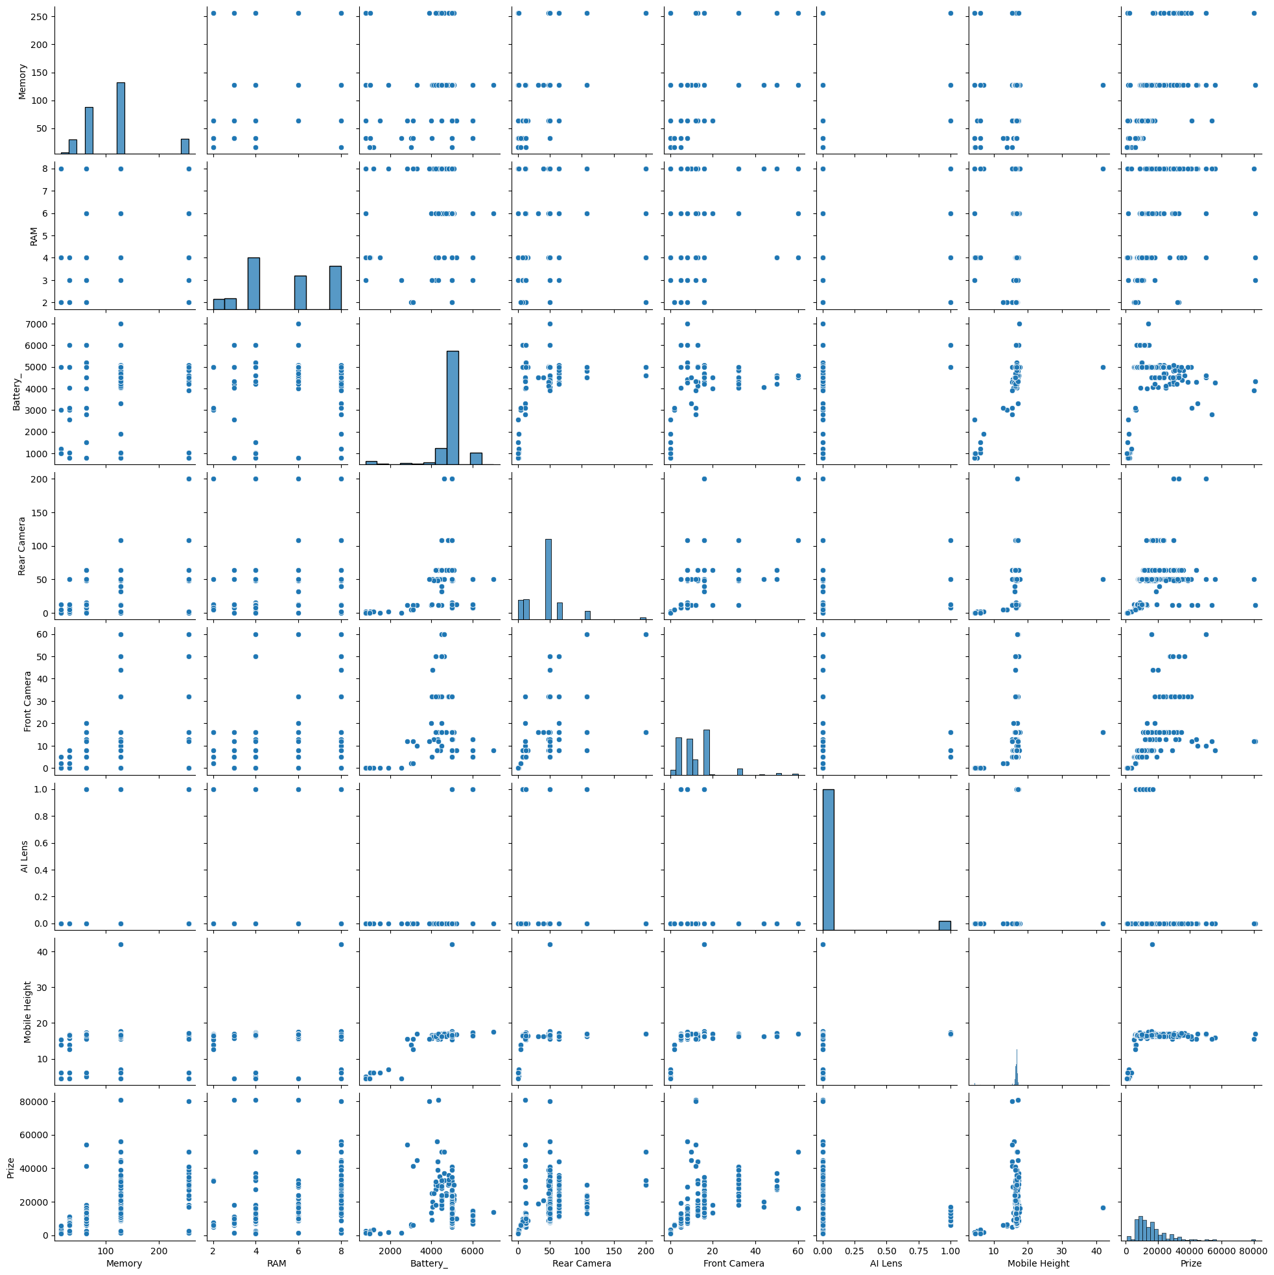
EDA on Numerical Columns

Slide 8
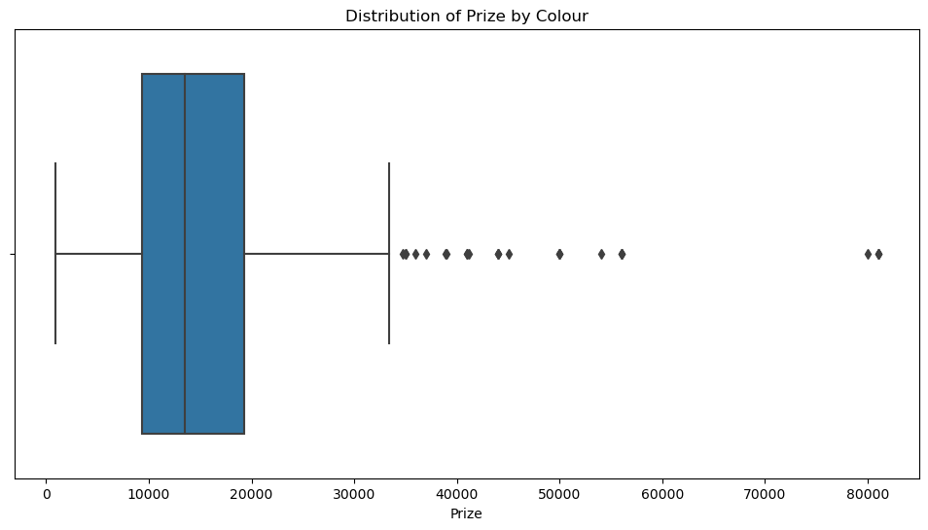
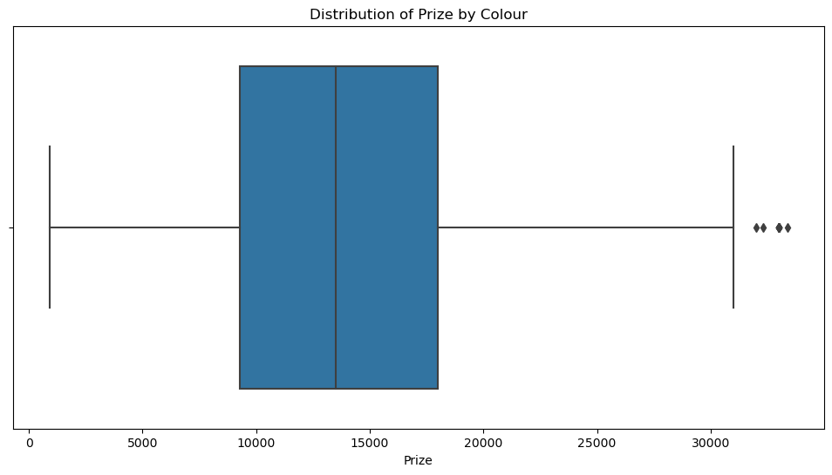
Box Plot for prize column before and after treating outliers

Slide 9
Insights
Memory and RAM Distribution: Memory and RAM have a relatively wide range of values, with a mean of around 110-120 GB and 5-6 GB respectively.
RAM Distribution: Many smartphones have 4 GB and 8 GB RAM, followed by 6 GB, while fewer have 2 GB and 3 GB RAM.
Scatter plot visualizes the relationship between RAM and Memory, with the color representing the Prize. It helps in understanding how the Prize varies concerning different combinations of RAM and Memory specifications in mobile devices. The plot suggests that higher RAM and Memory configurations tend to have higher prices, but there are exceptions, indicating other factors influencing pricing.

Slide 10
Feature Engineering
Using label encoder transfer the object column to a level
Using Standardscaler to scalled the numerical column and made it appropriate to use in model to predict the accurate Prize of mobile.

Slide 11
Model Building and Model Evaluation
For building model used the Sklearn library and divided the data into two parts as train and test data.
Used Linear Regression, RandomForestRegression, GradientBoostingRegression
The table presents performance metrics (MAE, MSE, RMSE) for different regression models (Linear Regression, Random Forest, Gradient Boosting). Random Forest and Gradient Boosting models exhibit significantly lower errors compared to Linear Regression across all metrics, indicating their superior predictive performance.
Model | MAE | MSE | RMSE
LinearRegression | 0.367453 | 0.281363 | 0.530436
RandomForest | 0.146421 | 0.061231 | 0.247450
GradientBoosting | 0.161787 | 0.056639 | 0.237989

Slide 12
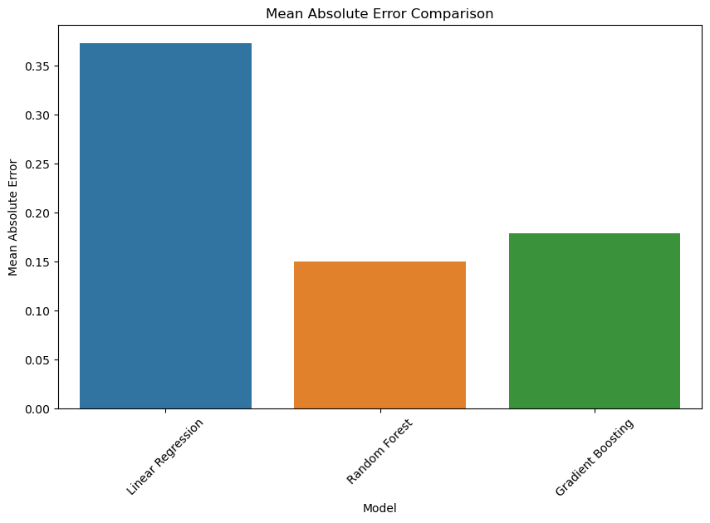
Showing result of model

Slide 13
Feature Important Analysis
The provided feature importances show the contribution of each feature to the predictive performance of the Random Forest and Gradient Boosting models.
Random Forest Feature Importances:
The most important feature is "Front Camera," followed by "Model" and "Phone Company."
Notably, "Battery_" and "AI Lens" have zero importance, indicating that they do not significantly contribute to the model's predictions.
Features like "Memory," "RAM," and "Rear Camera" also contribute to some extent but are less influential compared to "Front Camera" and other top features.
Gradient Boosting Feature Importances:
Similarly, "Front Camera" is the most important feature for the Gradient Boosting model, followed by "Phone Company" and "Processor_."
"Battery_" and "AI Lens" again have zero importance in this model.
The importance of features like "Memory," "RAM," and "Mobile Height" is consistent with the Random Forest model.
Overall, both models prioritize "Front Camera," "Model," and "Phone Company" as the most important features. However, there are slight differences in the rankings and importance values of other features between the two models.

Slide 14
Conclusion
This project is about Feature Extraction and Price Prediction for mobile phone using features like Battery, RAM, Camera, Processor, and Price.
We used the technique of EDA to analysis the relation and insight of data, data pre-processing for finding null values or duplicate values if any.
we used machine learning technique to build a model which helps to predict the price of mobile and by this its recommend that either to use Random Forest or Gradient Boosting both are effective for predicting the prise of mobile phone.

Slide 15
Thank You

